Slide 1
Markov Logic Network
Hung-yi Lee
Notes:
Continuous
Soft logic

Slide 2
Markov Logic Network
Markov Logic Network
Undirected Graph
Graphical Model
Structured Learning

Slide 3
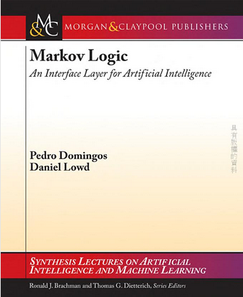
Textbook
Domingos, Pedro, and Daniel Lowd. "Markov logic: An interface layer for artificial intelligence." Synthesis Lectures on Artificial Intelligence and Machine Learning 3.1 (2009): 1-155.
Notes:
Toolkit
Tuffy: http://i.stanford.edu/hazy/hazy/tuffy/
alchemy.cs.washington.edu
Open-source software including:
Full first-order logic syntax
Inference (MAP and conditional probabilities)
Weight learning (generative and discriminative)
Structure learning
Programming language features

Slide 4

Machines use logic as humans?
Can machines do the inference as humans?
Bob 是否喜歡做研究?
Bob 喜歡做研究
Query:
Anna 和 Bob 是朋友
Anna 宅
Evidence:
Inference
1. 宅的人喜歡做研究
2. 物以類聚
Knowledge:
Notes:
Need a good case
By inference, humans use logic to discover the truth based on knowledge.

Slide 5
Machines use logic as humans?
This is also a structured learning problem.
Evaluation:
Evaluate how logical a world is
Represented as Graphical model?
Inference:
Given the knowledge base, how machines do the inference?
Training:
Determine the correctness of the given knowledge
Notes:
http://i.stanford.edu/hazy/papers/tuffy-vldb2011-slides.pdf
Ｔｏｎｉｇｈｔ：
Logic+world
Evaluation graphical
As repgression
learning
Inference:
二：slide
三：lifted
Training: 四 morning
More learning: 10
一 night
二 night
三 night

Slide 6
Grounding the predicates
Ground: Replace the variables in the predicates with all possible constant
Predicate:宅(x)
x: is a variable which can be any person
Person = {Anna, Bob}
constant
Grounding
宅(Anna)
宅(Bob)
宅(x)
Notes:
World: all the predicates
Some of the world is not “logical”
Part of the world is observed

Slide 7
World
World: Grounding all the predicates, and assign a truth value to each grounded predicate
Predicate: 是朋友(x,y), 宅(x), 做研究(y)
Person: {A, B, C}
是朋友(A,B)
是朋友(B,C)
是朋友(A,C)
宅(A)
宅(B)
宅(C)
做研究(A)
做研究(B)
做研究(C)
=T
=T
=T
=T
=T
=T
=T
=T
=T
是朋友(A,B)
是朋友(B,C)
是朋友(A,C)
宅(A)
宅(B)
宅(C)
做研究(A)
做研究(B)
做研究(C)
=F
=F
=F
=F
=F
=F
=F
=F
=F
U
U’
Notes:
World: all the predicates
Some of the world is not “logical”
Part of the world is observed

Slide 8

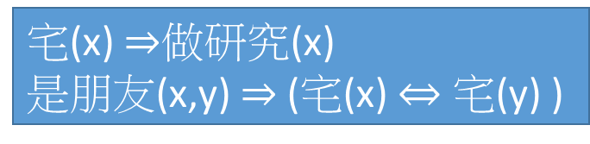
Evaluation
Given a knowledge base, some worlds do not let all the formulas be true
The world is not logical.
宅(x) $⇒$做研究(x)
是朋友(x,y) $⇒$ (宅(x) $⇔$ 宅(y) )
Knowledge Base L:
Person:
{A, B}
是朋友(A,B)
宅(A)
宅(B)
做研究(A)
做研究(B)
=T
=T
=T
=T
=T
是朋友(A,B)
宅(A)
宅(B)
做研究(A)
做研究(B)
=T
=T
=F
=T
=T
World U:
World U’:
L(U) = T
L(U’) = F

Slide 9
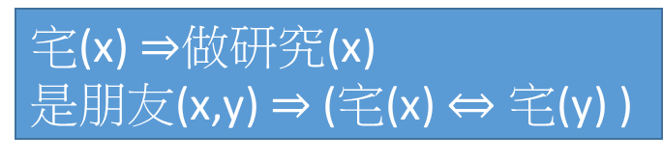
Inference
Knowledge Base L:
Evidence:
宅(x) $⇒$做研究(x)
是朋友(x,y) $⇒$ (宅(x) $⇔$ 宅(y) )
是朋友(A,B) =T
宅(A)=T
World U:
X
(evidence)
是朋友(A,B)
宅(A)
宅(B)
做研究(A)
做研究(B)
=T
=T
=?
=?
=?
是朋友(A,B)
宅(A)
宅(B)
做研究(A)
做研究(B)
=T
=T
=T
=T
=T
Check the 8 possible worlds
By L(U)
Y
(to be inferred)
There is only one logical world.

Slide 10
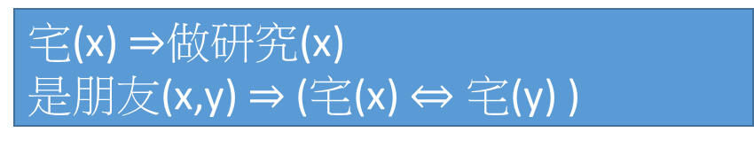
Soft Logic
The real world is complex.
Each formula is assigned a weight representing confidence score.
When a world violates a formula, It becomes less probable, but not impossible
L(U) = logical or not
L(U) = how logical it is
1.5
1.1
宅(x) $⇒$做研究(x)
是朋友(x,y) $⇒$ (宅(x) $⇔$ 宅(y) )
Notes:
永遠都會有不科學的事發生

Slide 11
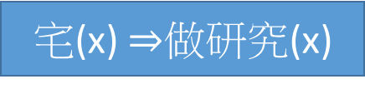
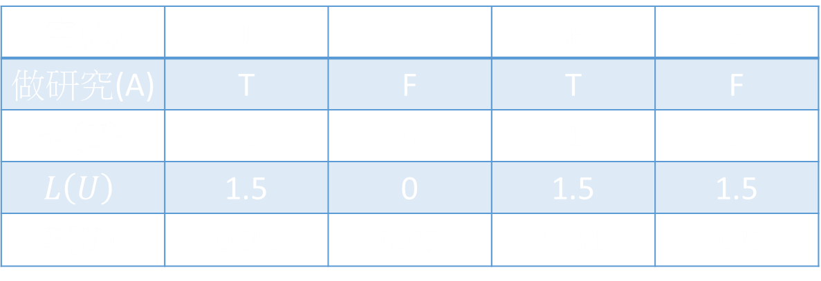


Soft Logic
If we observe that 宅(A) = T
P( 做研究(A) = T ) = 0.82
P( 做研究(A) = F ) = 0.18
Simple example
$$w_{1}$$
1.5
宅(x) $⇒$做研究(x)
$$f_{1}$$
Person = {Anna}
宅(A) | T | T | F | F
做研究(A) | T | F | T | F
$$n_{1}\left(U\right)$$ | 1 | 0 | 1 | 1
$$L\left(U\right)$$ | 1.5 | 0 | 1.5 | 1.5
$$P\left(U\right)$$ | 0.31 | 0.07 | 0.31 | 0.31
Notes:
Only Anna (A) in the world

Slide 12
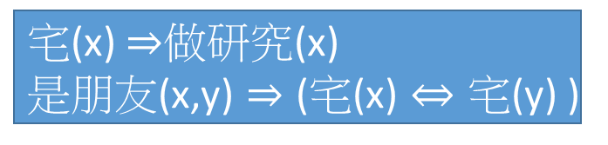

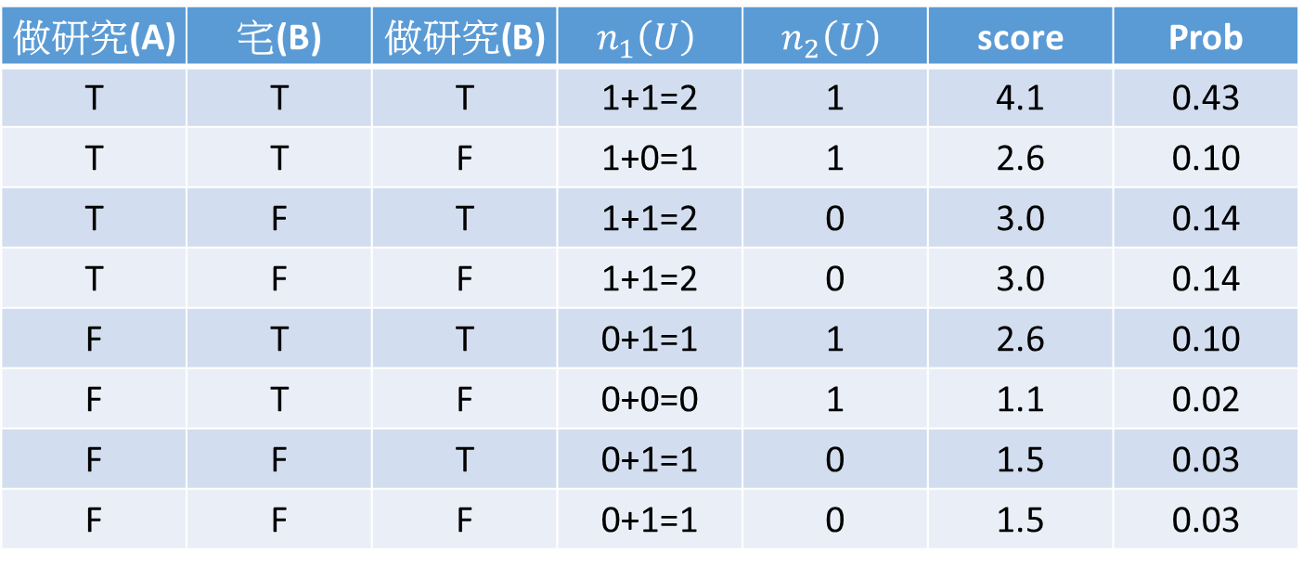



$$f_{1}$$
Evidence:
$$w_{1}$$
1.5
1.1
宅(x) $⇒$做研究(x)
是朋友(x,y) $⇒$ (宅(x) $⇔$ 宅(y) )
$$w_{2}$$
$$f_{2}$$
是朋友(A,B) =T
宅(A)=T
Person = {Anna, Bob}
做研究(A) | 宅(B) | 做研究(B) | $$n_{1}\left(U\right)$$ | $$n_{2}\left(U\right)$$ | score | Prob
T | T | T | 1+1=2 | 1 | 4.1 | 0.43
T | T | F | 1+0=1 | 1 | 2.6 | 0.10
T | F | T | 1+1=2 | 0 | 3.0 | 0.14
T | F | F | 1+1=2 | 0 | 3.0 | 0.14
F | T | T | 0+1=1 | 1 | 2.6 | 0.10
F | T | F | 0+0=0 | 1 | 1.1 | 0.02
F | F | T | 0+1=1 | 0 | 1.5 | 0.03
F | F | F | 0+1=1 | 0 | 1.5 | 0.03
Q: Bob 是否喜歡做研究?
A: 70% 的機率 Bob 喜歡做研究

Slide 13



Soft Logic
$L\left(U\right)$: How logical a world X is given knowledge base L
Probability point of view:
Sum over all formulas in knowledge base
$$L\left(U\right)=\sum_{i}{w_{i}n_{i}\left(U\right)}$$
No. of times formula i is true
Weight of formula i
$$P\left(U\right)=\frac{e^{L\left(U\right)}}{\sum_{U^{′}}{e^{L\left(U^{′}\right)}}}$$
(The probability that the world X appears.)

Slide 14




Inference
Find most likely state of world given evidence
World U = {X, Y}, X is given, Y is the target to be found
$$=arg\max_{Y}{\sum_{i}{w_{i}n_{i}\left(X,Y\right)}}$$
$$\tilde{Y}=arg\max_{Y}{L\left(X,Y\right)}$$
$$=arg\max_{Y}{\frac{e^{L\left(X,Y\right)}}{\sum_{Y^{′}}{e^{L\left(X,Y^{′}\right)}}}}$$
$$\tilde{Y}=arg\max_{Y}{P\left(Y|X\right)}$$
Notes:
This is just the weighted MaxSAT problem
Use weighted SAT solver (e.g., MaxWalkSAT [Kautz et al., 1997]

Slide 15










Graphical Model
1.5
1.1
宅(x) $⇒$做研究(x)
是朋友(x,y) $⇒$ (宅(x) $⇔$ 宅(y) )
$$f_{1}$$
Each ground predicate is a node.
$$f_{2}$$
The formulas are Factors.
是朋友(A,B)
T
$f_{2}\left( \text{是朋友}\text{(}\text{A}\text{,}\text{B}\right) ,\text{宅}\text{(}\text{A}\text{)}$ , 宅(B) )
$$f_{2}$$
宅(A)
T
$$+$$
$f_{1} (\text{宅}\text{(}\text{A}\text{)}$ , 做研究(A) )
宅(B)
$$f_{1}$$
$$+$$
做研究(A)
$f_{1}\text{( }\text{宅}\text{(}\text{B}\text{) ,} \text{做研究}\text{(}\text{B}\text{)}$)
做研究(B)
$$f_{1}$$
$$=$$
$$L\left(U\right)$$

Slide 16
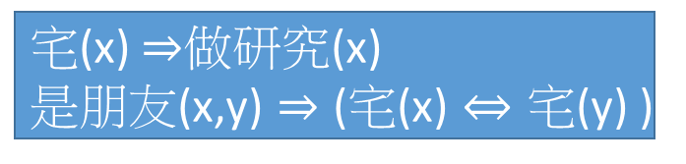











$$w_{1}$$
1.5
1.1
宅(x) $⇒$做研究(x)
是朋友(x,y) $⇒$ (宅(x) $⇔$ 宅(y) )
$$f_{1}$$
$$w_{2}$$
$$f_{2}$$
$$f_{1} (\text{宅}\text{(}\text{x}\text{) , }\text{做研究}\text{(}\text{x}\text{) ) =}\left\{\begin{matrix}w_{1} \\ 0\end{matrix}\right.$$
$\left(\text{宅}\text{(}\text{x}\text{) }⇒\text{做研究}\text{(}\text{x}\text{)}\right)$ is true
$$otherwise$$
是朋友(A,B)
T
$f_{2}\left( \text{是朋友}\text{(}\text{A}\text{,}\text{B}\right) ,\text{宅}\text{(}\text{A}\text{)}$ , 宅(B) )
$$f_{2}$$
宅(A)
T
$$+$$
$f_{1} (\text{宅}\text{(}\text{A}\text{)}$ , 做研究(A) )
宅(B)
$$f_{1}$$
$${=w}_{1}$$
$$=0$$
$$+$$
做研究(A)
T
F
$f_{1}\text{( }\text{宅}\text{(}\text{B}\text{) ,} \text{做研究}\text{(}\text{B}\text{)}$)
做研究(B)
$$f_{1}$$
$$=$$
$$L\left(X\right)$$
Notes:
How about the lower f1 …

Slide 17





$$w_{1}$$
1.5
1.1
宅(x) $⇒$做研究(x)
是朋友(x,y) $⇒$ (宅(x) $⇔$ 宅(y) )
$$f_{1}$$
$$w_{2}$$
$$f_{2}$$
$\left(\text{是朋友}\text{(}\text{x}\text{,}\text{y}\text{) }⇒ \text{(}\text{宅}\text{(}\text{x}\text{) }⇔\text{ 宅}\text{(}\text{y}\text{) ) }\right)$ is true
$$f_{2}\left( \text{是朋友}\text{(}\text{A}\text{,}\text{B}\right) ,\text{宅}\text{(}\text{A}\text{) , }\text{宅}\text{(}\text{B}\text{) )=}\left\{\begin{matrix}w_{2} \\ 0\end{matrix}\right.$$
$$otherwise$$
是朋友(A,B)
T
$f_{2}\left( \text{是朋友}\text{(}\text{A}\text{,}\text{B}\right) ,\text{宅}\text{(}\text{A}\text{)}$ , 宅(B) )
$$f_{2}$$
$${=w}_{2}$$
$$=0$$
宅(A)
T
$$+$$
$f_{1} (\text{宅}\text{(}\text{A}\text{)}$ , 做研究(A) )
宅(B)
T
F
$$f_{1}$$
$$+$$
做研究(A)
$f_{1}\text{( }\text{宅}\text{(}\text{B}\text{) ,} \text{做研究}\text{(}\text{B}\text{)}$)
做研究(B)
$$f_{1}$$
$$=$$
$$L\left(X\right)$$

Slide 18



Graphical Model
Factor Graph
Markov Random Field
是朋友(A,B)
是朋友(A,B)
$$f_{2}$$
宅(A)
宅(A)
宅(B)
宅(B)
$$f_{1}$$
做研究(A)
做研究(B)
$$f_{1}$$
做研究(A)
做研究(B)
This is why the model is named Markov Logic Network

Slide 19





Learning the Correctness
Given a set of formulas {$F_{1}⋯F_{i}⋯F_{N}$} and world U, assign weights {$w_{1}⋯w_{i}⋯w_{N}$} for each formulas
Maximizing the likelihood of world $P\left(U\right)$
$$P\left(U\right)=\frac{e^{L\left(U\right)}}{\sum_{U^{′}}{e^{L\left(U^{′}\right)}}}$$
$$L\left(U\right)=\sum_{i}{w_{i}n_{i}\left(U\right)}$$
$$logP\left(U\right)=L\left(U\right)−log\sum_{U^{′}}{e^{L\left(U^{′}\right)}}$$
$$w_{i}←w_{i}+η\frac{∂logP\left(U\right)}{∂w_{i}}$$
Gradient ascent:

Slide 20
Learning the Correctness
If there is some missing data in the world
U
是朋友(A,B)
是朋友(B,C)
是朋友(A,C)
宅(A)
宅(B)
宅(C)
做研究(A)
做研究(B)
做研究(C)
=T
=T
=T
=T
=T
=T
=T
=T
=T
是朋友(A,B)
是朋友(B,C)
是朋友(A,C)
宅(A)
宅(B)
宅(C)
做研究(A)
做研究(B)
做研究(C)
=T
=?
=T
=?
=T
=?
=T
=?
=T
Observed
world
Hidden world
X
H

Slide 21



Learning the Correctness
If there is some missing data in the world
X: observed part of the world, H: missing part
$$P\left(X\right)=\sum_{H^{′}}{P\left(X,H^{′}\right)}$$
Everything you don’t observe can happen
$$\frac{∂logP\left(X\right)}{∂w_{i}}=\sum_{H^{′}}{P\left(X,H^{′}\right)n_{i}\left(X,H^{′}\right)}$$
$$−\sum_{X^{′},H^{′}}{P\left(X^{′},H^{′}\right)n_{i}\left(X^{′},H^{′}\right)}$$

Slide 22
Learning the Correctness - UW-CSE database
Available: http://www.cs.washington.edu/ai/mln/database.html
1158 constants: person, course, paper title ……
22 predicates: Professor(x), AdvicedBy(x,y)
4M grounding predicates, 3k are true
94 hand-crafted formulas are given
Learn the weight
Notes:
University of Washington Department of Computer Science and Engineering.

Slide 23
Learning the Correctness - UW-CSE database
The formulas with the highest weights
(Couse c is taught by x) => (x is a professor) 3.5
(x is advised by y) => (y is the co-author of the paper x published) 3.1
One of the formulas with negative weights
EXIST y: (x is a student) => (x is advised by y) or (x is temporarily advised by y) -1.2
Notes:
Can we have anoehr data based !!!!!!!!!!!!!!!!!!!!!!!!!!!
(x and y are co-author of an paper) and (x and y are not the same person) => (x is advised by y) or (x is advised by y) 4.4
!publication(t,a) v !publication(t,b) v samePerson(a,b) v advisedBy(a,b) v advisedBy(b,a) 4.41667
!taughtBy(c,p,q) v professor(p) 3.48386
!advisedBy(s,p) v !publication(t,s) v publication(t,p) 3.11666
!inPhase(s,Post_Generals) v !taughtBy(c,p,q) v ta(c,s,q) v courseLevel(c,Level_100) v !advisedBy(s,p) -0.646597
!inPhase(p,x) v samePhase(x,y) v !inPhase(p,y) -1.0232

Slide 24
Outlook
Markov Logic Network can learn more than just weights
It can ……
Discover the knowledge
Discover the predicates
Transfer Learning
Unsupervised Learning

